Slide 1
Let’s Get to Know You Better
Have more than 2 accounts
2. You use the same usernames and passwords for most of your accounts
3. Save your usernames and passwords on your browser
4. Believe that your usernames and passwords are safe
Penny Vo & Allen Scott

Slide 2
Advanced Encryption Password Manager
AES Encryption
+ Erasure Code
+ Virtual Machines
Penny Vo & Allen Scott

Slide 3
HE Purposes:
Hard to be stolen
Easy to remember
Penny Vo & Allen Scott

Slide 4
AES Encryption + Decryption
key
My_Password File
Encrypted File
key
Penny Vo & Allen Scott

Slide 5
Erasure Code (Reed-Solomon)
n
k (k <= n)
File
File
Encode
Decode
Penny Vo & Allen Scott

Slide 6


Notes:
Vulnerabilities in an attack is once a computer is attacked an corrupted if all the information about the passwords is only on one machine then once that machine is corrupted then the passwords are leaked. Our solution is to distribute these encripted files among virtual machines then delete them off our computer

Slide 7
File Transfer
Python Library
SSH File Transfer
Penny Vo & Allen Scott

Slide 8

Notes:
If we expand this idea to a company level we could create server farms across different geographical locations to make physical intrusion much more difficult

Slide 9

Novelty????
Erasure Code
MASTER PASSWORD
Virtual Machine File Storage
AES Encryption
Penny Vo & Allen Scott
Notes:
Our novelty is not any of these idea themselves but the connection between all of them.

Slide 10
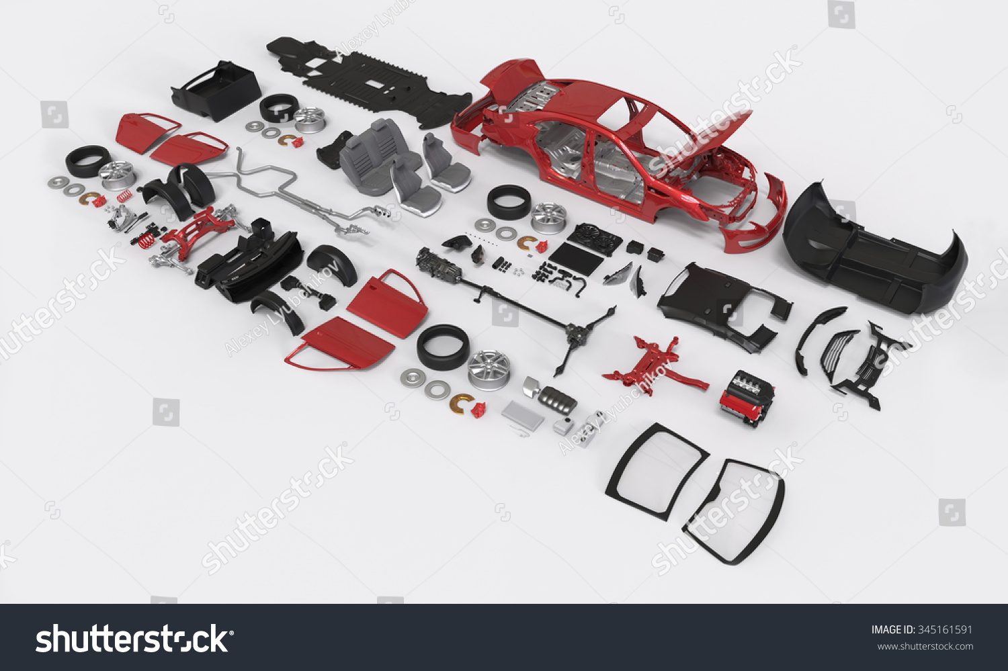

Slide 11
Q&A????
Penny Vo & Allen Scott

